Slide 1
Docker
Container management service
Platform for packaging, deploying and running application

Slide 2
Docker file
Text document which used to build docker image
Docker file sructure
  FROM : For base image, must be top of docker file
  RUN : To execute command
  MAINTAINER : Used to tell who maintaining this Dockerfile
  CMD : Specified command line command to execute when Docker container is start up
  COPY : Copies one or more files from the docker host
  ADD : Copy and extract TAR files from Docker host to Docker image,also can downloade files via HTTP and copy them into the docker image
  ENV : Set an enivornment variable inside the docker image
  ARG : Define the name of a paramenter and its default value
  WORKDIR : Specifies what the working directory should be inside the Docker image
  EXPOSE : Open up network ports in the Docker container to the outside world
  VOLUME : Created a directory inside docker image which act as storage
  ENTRYPOINT : Similar to CMD but have higher priority over CMD

Slide 3
Basic docker command
Docker search : Search for public image on the docker hub
Docker pull : used to pull image from docker hub
Docker image : list of all local image
Docker run <image_name> : create container from image
Docker ps : list of all running container
Docker ps -a : list of all container(Running +Stop)
Docker stop <container_id>or<container_name> : to stop container
Docker attach : attach to a running container using the container’s ID or name,
Docker restart <container_id> : Restart stoped container
Docker rename <old_name> <new_name> : Rename container name
Docker logs <container_name> : helpful to debug docker container
Docker stop <container_name> : stop the container
Docker rm <container_name > : remove container
Docker rmi <image_id> : To remove image

Slide 4
Docker compose
A tool that was developed to help define and share multi-container applications.
Used to run multiple containers as single service

Slide 5
Docker compose file
Version : denotes version of docker compose
Services : define all container we will create
Build : specifies the location of our dockerfile
ports : map the container port to the host machine
volumes : directroy used to store data which is generated and used by docker container
links : link one service to another
Image : if we don’t have dockerfile we specify image location using it
enivorment : allows to set up an enivormental variable
command : execute action when container started

Slide 6
Docker-compose command
Docker-compose build : to build the services
Docker-compose up -d : Start all service in detached mode
Docker-compose down : Stop all service
Docker-compose -v : to check version
Docker-compose images : list all the image that docker compose built
Docker-compose ps : list all the running container that docker-compose built
Docker-compose start <service_name>: Start existing conatiner for the service
Docker-compose stop <service_name>: Stop running container without removing it
Docker-compose top :list running processes
Docker-compose kill <service-name>:forces running container to stop
Docker-compose rm <service-name> : remove the stopped service container
Docker-compose config : to validate the docker-compose file

Slide 7
ZMQ
high-performance asynchronous messaging library
  Pair
  Client/Server
  Publish/Subscribe

Slide 8
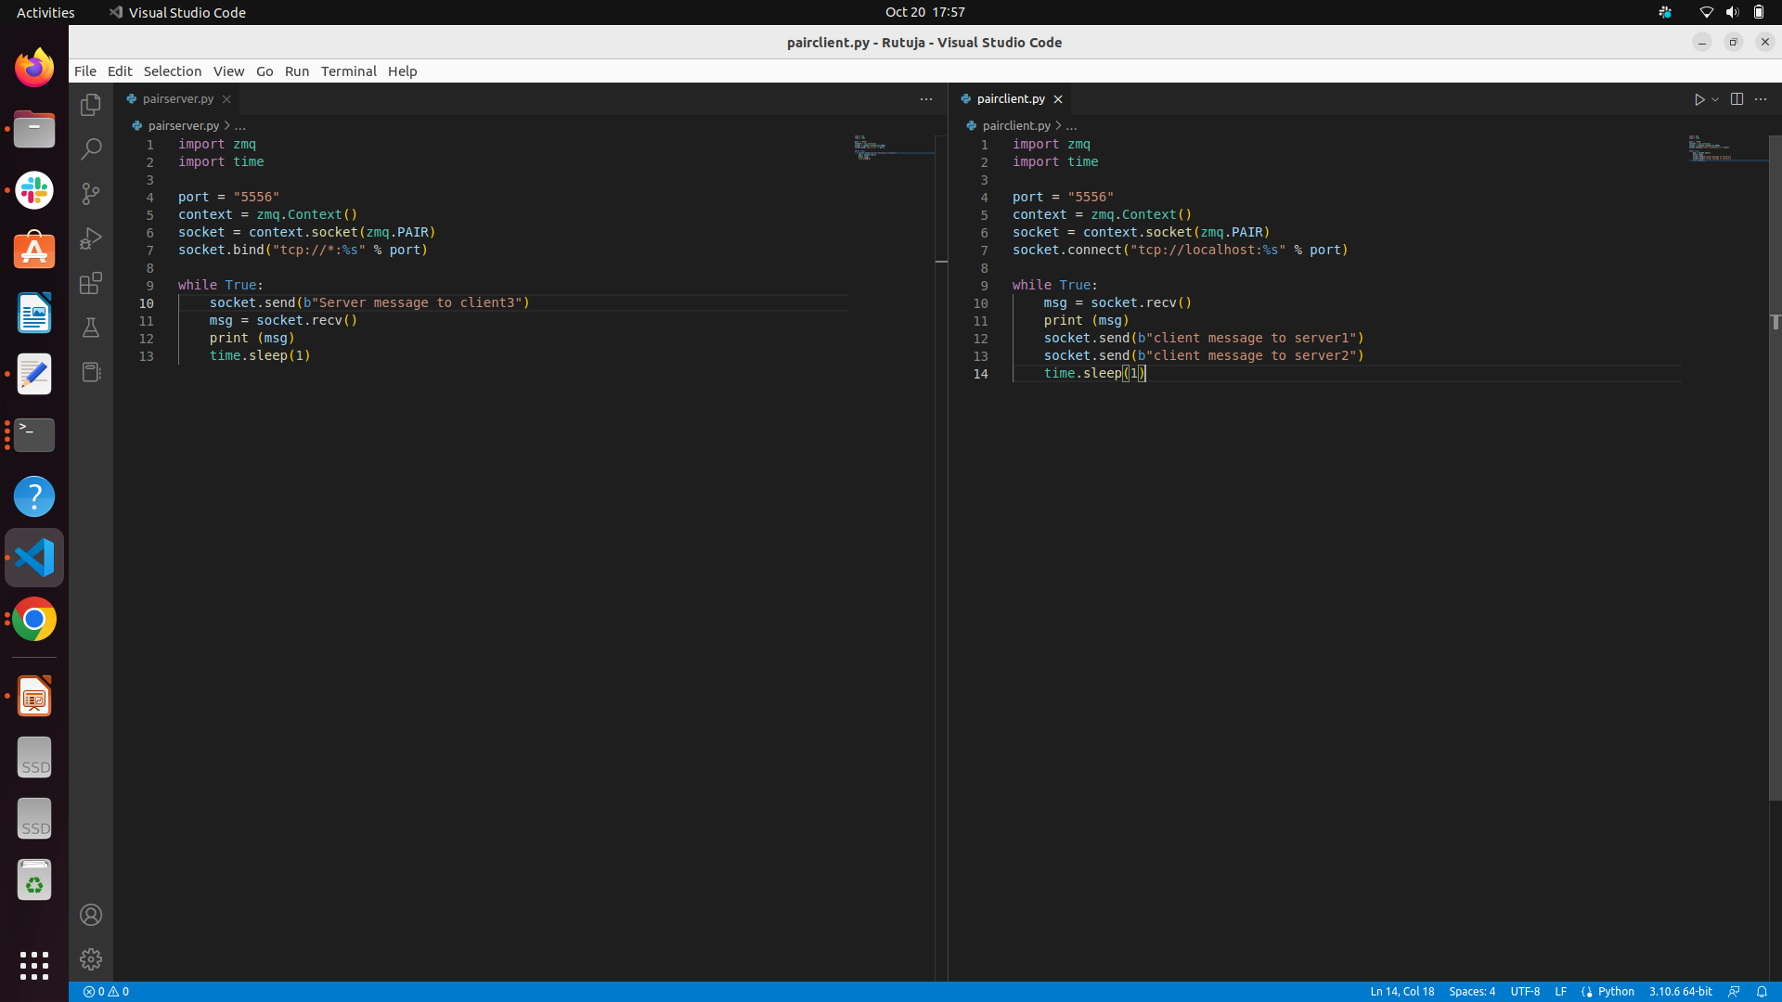
Pair

Slide 9
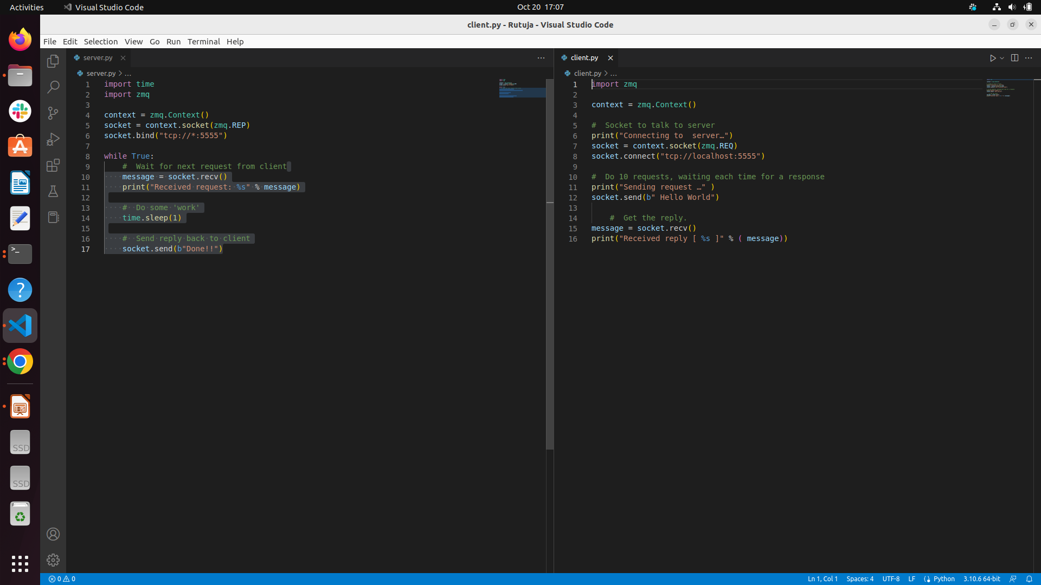
Client/Server(Request/Response)

Slide 10
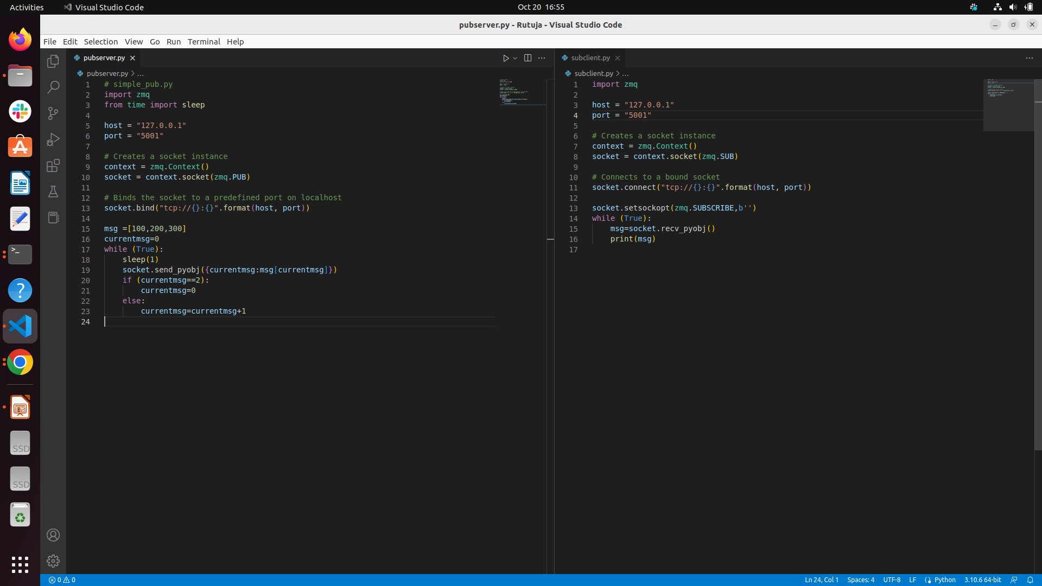
Publish/Subscribe

